Slide 1
Module 3:
Arrays and Strings

Slide 2
Arrays, Structures And Unions
One dimensional array
Multidimensional array
Declaration and Initialization of Arrays
Reading and Displaying arrays
String and its related functions

Slide 3
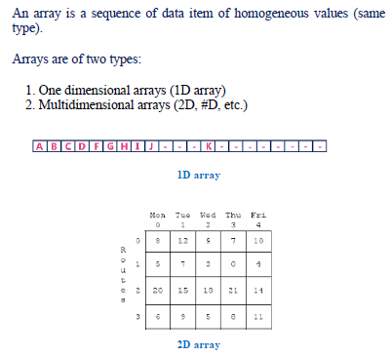
Arrays, Structures And Unions

Slide 4
Arrays, Structures And Unions
An array is defined as an ordered set of similar data items. All the data items of an array are stored in consecutive memory locations in RAM. The elements of an array are of same data type and each item can be accessed using the same name.
Declaration of an array:- We know that all the variables are declared before the are used in the program. Similarly, an array must be declared before it is used. During declaration, the size of the array has to be specified. The size used during declaration of the array informs the compiler to allocate and reserve the specified memory locations.
Syntax:- data_type array_name[n];
where, n is the number of data items (or) index(or) dimension.
0 to (n-1) is the range of array.
Ex: int a[5];
float x[10];

Slide 5
Arrays, Structures And Unions
Initialization of Arrays:-
The different types of initializing arrays:
1. At Compile time
(i) Initializing all specified memory locations.
(ii) Partial array initialization
(iii) Initialization without size.
(iv) String initialization.
2. At Run Time

Slide 6

Arrays, Structures And Unions
1. Compile Time Initialization
We can initialize the elements of arrays in the same way as the ordinary variables when they are declared. The general form of initialization of arrays is
Type array-name[size]={ list of values};
(i) Initializing all specified memory locations:- Arrays can be initialized at the time of declaration when their initial values are known in advance. Array elements can be initialized with data items of type int, char etc.
Ex:- int a[5]={10,15,1,3,20};
float b[3]={0.2,2.1,4.5};
printf(“b[0]=%f\tb[1]=%f\tb[2]=%f”,b[0],b[1],b[2]);
During compilation, 5 contiguous memory locations are reserved by the compiler for the variable a and all these locations are initialized as shown in figure.
Fig: Initialization of int Arraysx:-
int a[3]={9,2,4,5,6}; //error: no. of initial vales are more than the size of array.

Slide 7

Arrays, Structures And Unions
1. Compile Time Initialization
(ii) Partial array initialization:- Partial array initialization is possible in c language. If the number of values to be initialized is less than the size of the array , then the elements will be initialized to zero automatically.
Ex:-
int a[5]={10,15};
Eventhough compiler allocates 5 memory locations, using this declaration statement; the compiler initializes first two locations with 10 and 15, the next set of memory locations are automatically initialized to 0's by compiler as shown in figure.
Fig: Partial Array Initialization

Slide 8

Arrays, Structures And Unions
1. Compile Time Initialization
Initialization with all zeros:-
Ex:-
int a[5]={0};

Slide 9

Arrays, Structures And Unions
1. Compile Time Initialization
(iii) Initialization without size:- Consider the declaration along with the initialization.
Ex:-
char b[]={'C','O','M','P','U','T','E','R'};
In this declaration, eventhough we have not specified exact number of elements to be used in array b, the array size will be set of the total number of initial values specified. So, the array size will be set to 8 automatically. the array b is initialized as shown in figure.
Fig: Initialization without size
Ex:- int ch[]={1,0,3,5} // array size is 4

Slide 10

Arrays, Structures And Unions
1. Compile Time Initialization
(iv) Array initialization with a string: - Consider the declaration with string initialization.
Ex:-
char b[]="COMPUTER";
The array b is initialized as shown in figure.
Fig: Array Initialized with a String
Eventhough the string "COMPUTER" contains 8 characters, because it is a string. It always ends with null character. So, the array size is 9 bytes (i.e., string length 1 byte for null character).
Ex:-
char b[9]="COMPUTER";
char b[8]="COMPUTER";

Slide 11
Arrays, Structures And Unions
1. Compile Time Initialization
(iv) Array initialization with a string: - Consider the declaration with string initialization.
Ex:-
char b[]="COMPUTER";
The array b is initialized as shown in figure.
Fig: Array Initialized with a String
Eventhough the string "COMPUTER" contains 8 characters, because it is a string. It always ends with null character. So, the array size is 9 bytes (i.e., string length 1 byte for null character).
Ex:-
char b[9]="COMPUTER"; // correct
char b[8]="COMPUTER"; // wrong

Slide 12
Arrays, Structures And Unions
Task
Consider an array of integer, float and character with Compile Time Initialization
Display all elements in an array
Display any particular value/ character from the array
x[0]= x[1]= x[2]= x[3]=
And as
x[0]=
x[1]=…

Slide 13
Arrays, Structures And Unions
2. Run Time Initialization
An array can be explicitly initialized at run time. This approach is usually applied for initializing large arrays.
Ex:- scanf can be used to initialize an array.
Int x[3];
Scanf(“%d%d%d”,&x[0],&x[1],&x[2]);
The above statements will initialize array elements with the values entered through the key board.
TASK
Consider an array of 4 elements and display using scanf and printf as
x[0]= x[1]= x[2]= x[3]=
And as
x[0]=
x[1]=…

Slide 14
Arrays, Structures And Unions
2. Run Time Initialization
OR
float Sum[150];
For(i=0;i<100;i=i+1)
{
If(i<50)
Sum[i]=0.0;
Else
Sum[i]=1.0;
}

Slide 15
Arrays, Structures And Unions
2. Run Time Initialization
OR
float Sum[150];
For(i=0;i<100;i=i+1)
{
If(i<50)
Sum[i]=0.0;
Else
Sum[i]=1.0;
}
The first 50 elements of the array sum are initialized to 0 while the remaining 50 are initialized to 1.0 at run time.

Slide 16
Arrays, Structures And Unions
2 D arrays
An array consisting of two subscripts is known as two-dimensional array. These are often known as array of the array. In two dimensional arrays the array is divided into rows and columns,. These are well suited to handle the table of data. In 2-D array we can declare an array as :
Declaration:-
Data_type array_name[row_size][column_size] = {{list of first row elements},
{list of second row elements},….
{list of last row elements}};
Ex:- int arr[3][3];
where first index value shows the number of the rows and second index value shows the no. of the columns in the array.
Initialization:-
int arr[3][3] = {{ 1, 2, 3},{4, 5, 6},{7, 8, 9}};

Slide 17
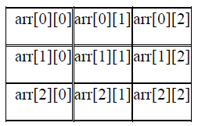
Arrays, Structures And Unions
2 D arrays: Memory storage
These are stored in the memory as given below.
Row-Major order Implementation
Column-Major order Implementation
In Row-Major Implementation of the arrays, the arrays are stored in the memory in terms of the row design, i.e. first the first row of the array is stored in the memory then second and so on. Suppose we have an array named arr having 3 rows and 3 columns then it can be stored in the memory in the following manner :

Slide 18

Arrays, Structures And Unions
2 D arrays: Memory storage: Row-Major Implementation
int arr[3][3];
Thus an array of 3*3 can be declared as follows :
arr[3][3] = { 1, 2, 3,
4, 5, 6,
7, 8, 9 };
and it will be represented in the memory with row major implementation as follows :

Slide 19
Arrays, Structures And Unions
2 D arrays: Memory storage: Column-Major Implementation
The arrays are stored in the memory in the term of the column design, i.e. the first column of the array is stored in the memory then the second and so on.
int arr[3][3];
Thus an array of 3*3 can be declared as follows :
arr[3][3] = { 1, 2, 3,
4, 5, 6,
7, 8, 9 };
and it will be represented in the memory with column major implementation as follows :

Slide 20

Arrays, Structures And Unions
2 D arrays: Memory storage: Column-Major Implementation
int arr[3][3];
Thus an array of 3*3 can be declared as follows :
arr[3][3] = { 1, 2, 3,
4, 5, 6,
7, 8, 9 };
and it will be represented in the memory with column major implementation as follows :

Slide 21
Arrays, Structures And Unions
2 D arrays:
To initialize values for variable length arrays we can use scanf statement & loop constructs.
int arr[5][5];
for (i=0 ; i<3; i++)
for(j=0;j<3;j++)
scanf(“%d”,&arr[i][j]);
Task:
Consider 2-D array, display the 2-D array and also display any particular element or specified by user from it

Slide 22
Arrays, Structures And Unions
2 D arrays:
To initialize values for variable length arrays we can use scanf statement & loop constructs.
int arr[5][5];
for (i=0 ; i<3; i++)
for(j=0;j<3;j++)
scanf(“%d”,&arr[i][j]);
Task:
Consider 2-D array, display the 2-D array and also display any particular element

Slide 23
Arrays, Structures And Unions
Multidimensional #D arrays:
Syntax:
Data_type arrat_name[size1][size2][size3]------[sizeN];
int arr[3][3][3] =
{ 1, 2, 3,
4, 5, 6,
7, 8, 9,
10, 11, 12,
13, 14, 15,
16, 17, 18,
19, 20, 21,
22, 23, 24,
25, 26, 27 };
/* here we have divided array into grid for sake of convenience as in above declaration we have created 3 different grids, each have rows and columns */
If we want to access the element the in 3-D array we can do it as follows :
printf("%d",&arr[2][2][2]);
Output=?

Slide 24
Arrays, Structures And Unions
Multidimensional #D arrays:
Syntax:
Data_type arrat_name[size1][size2][size3]------[sizeN];
int arr[3][3][3] =
{ 1, 2, 3,
4, 5, 6,
7, 8, 9,
10, 11, 12,
13, 14, 15,
16, 17, 18,
19, 20, 21,
22, 23, 24,
25, 26, 27 };
/* here we have divided array into grid for sake of convenience as in above declaration we have created 3 different grids, each have rows and columns */
If we want to access the element the in 3-D array we can do it as follows :
printf("%d",a[2][2][2]);
Output=?
27
Array indexing start with zero

Slide 25
Arrays, Structures And Unions
Task
Addition of 2-D array (2 * 2)
Display both the array
Display added array

Slide 26
main( )
{ int *arr[4] ; /* array of integer pointers */
int i = 31, j = 5, k = 19, l = 71, m ;
arr[0] = &i ; arr[1] = &j ; arr[2] = &k ; arr[3] = &l ;
for ( m = 0 ; m <= 3 ; m++ )
printf ( "%d ", * ( arr[m] ) ) ; }

Slide 27
Arrays, Structures And Unions
Task: Addition of 2-D array (2 * 2)
#include<stdio.h>
void main()
{
int i,j;
int a[2][2]={1,2,3,4};
int b[2][2]={1,2,3,4};
int c[2][2];
for(i=0;i<2;i++)
{
for(j=0;j<2;j++)
{
printf("%2d",a[i][j]);
}
printf("\n\n");
}
for(i=0;i<2;i++)
{
for(j=0;j<2;j++)
{
printf("%2d",b[i][j]);
}
printf("\n\n");
}
printf("\n The addition of given two matrices is\n");
for(i=0;i<2;i++)
{
for(j=0;j<2;j++)
{
c[i][j]=a[i][j]+b[i][j];
}
}
for(i=0;i<2;i++)
{
for(j=0;j<2;j++)
{
printf("%2d",c[i][j]);
}
printf("\n\n");
}
getch();
}

Slide 28
Arrays, Structures And Unions
Character Arrays and Strings: Introduction, Declaring and Initializing String Variables, Reading Character and Writing Character, Reading and Writing Strings, String Handling Functions

Slide 29
Character Arrays and Strings: Introduction, Declaring and Initializing String Variables, Reading Character and Writing Character, Reading and Writing Strings
Arrays, Structures And Unions
Array declaration and initialization with a character/string: - Consider the declaration with string initialization.
Ex:-
char b[]="COMPUTER";
The array b is initialized as shown in figure.
Fig: Array Initialized with a String
Eventhough the string "COMPUTER" contains 8 characters, because it is a string. It always ends with null character. So, the array size is 9 bytes (i.e., string length 1 byte for null character).
Ex:-
char b[9]="COMPUTER";
char b[8]="COMPUTER";

Slide 30
Character Arrays and Strings: Introduction, Declaring and Initializing String Variables, Reading Character and Writing Character, Reading and Writing Strings
Arrays, Structures And Unions
Array declaration and initialization with a character/string: - Consider the declaration with string initialization.
Ex:-
char b[]="COMPUTER";
The array b is initialized as shown in figure.
Fig: Array Initialized with a String
Eventhough the string "COMPUTER" contains 8 characters, because it is a string. It always ends with null character. So, the array size is 9 bytes (i.e., string length 1 byte for null character).
Ex:-
char b[9]="COMPUTER"; // correct
char b[8]="COMPUTER"; // wrong

Slide 31
Character Arrays and Strings: Introduction, Declaring and Initializing String Variables, Reading Character and Writing Character, Reading and Writing Strings
Arrays, Structures And Unions
Task
Consider an array of integer, float and character with Compile Time Initialization
Display all elements in an array
Display any particular value/ character from the array
x[0]= x[1]= x[2]= x[3]= And as
x[0]=
x[1]=…
#include <stdio.h> Output?
int main ()
{
char greeting[6] = {'H', 'e', 'l', 'l', 'o', '\0'};
printf("Greeting message: %s\n", greeting );
return 0;
}

Slide 32
Character Arrays and Strings: Introduction, Declaring and Initializing String Variables, Reading Character and Writing Character, Reading and Writing Strings
Arrays, Structures And Unions
Task
Consider an array of integer, float and character with Compile Time Initialization
Display all elements in an array
Display any particular value/ character from the array
x[0]= x[1]= x[2]= x[3]= And as
x[0]=
x[1]=…
#include <stdio.h> Output?
int main ()
{ Greeting Message:Hello
char greeting[6] = {'H', 'e', 'l', 'l', 'o', '\0'};
printf("Greeting message: %s\n", greeting );
return 0;
}

Slide 33
Character Arrays and Strings: Introduction, Declaring and Initializing String Variables, Reading Character and Writing Character, Reading and Writing Strings
Arrays, Structures And Unions
#include <stdio.h>
#include <string.h>
int main()
{
/* String Declaration*/
char nickname[20];
printf("Enter your Nick name:");
/* I am reading the input string and storing it in nickname
* Array name alone works as a base address of array so
* we can use nickname instead of &nickname here
*/
scanf("%s", nickname);
/*Displaying String*/
printf("%s",nickname);
return 0;
}
#include <stdio.h>
#include <string.h>
int main()
{
/* String Declaration*/
char nickname[20];
/* Console display using puts */
puts("Enter your Nick name:");
/*Input using gets*/
gets(nickname);
puts(nickname);
return 0;
}

Slide 34
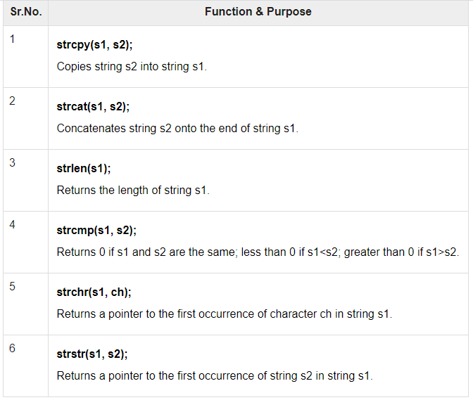
String Handling Functions
Arrays, Structures And Unions

Slide 35
String Handling Functions
Arrays, Structures And Unions
#include <stdio.h>
#include <string.h>
int main () {
char str1[12] = "Hello";
char str2[12] = "World";
char str3[12];
int len ;
/* copy str1 into str3 */
strcpy(str3, str1);
printf("strcpy( str3, str1) : %s\n", str3 );
/* concatenates str1 and str2 */
strcat( str1, str2);
printf("strcat( str1, str2): %s\n", str1 );
/* total lenghth of str1 after concatenation */
len = strlen(str1);
printf("strlen(str1) : %d\n", len );
return 0;
}
Output?

Slide 36
String Handling Functions
Arrays, Structures And Unions
#include <stdio.h>
#include <string.h>
int main () {
char str1[12] = "Hello";
char str2[12] = "World";
char str3[12];
int len ;
/* copy str1 into str3 */
strcpy(str3, str1);
printf("strcpy( str3, str1) : %s\n", str3 );
/* concatenates str1 and str2 */
strcat( str1, str2);
printf("strcat( str1, str2): %s\n", str1 );
/* total lenghth of str1 after concatenation */
len = strlen(str1);
printf("strlen(str1) : %d\n", len );
return 0;
}
Output?
strcpy( str3, str1) : Hello
strcat( str1, str2): HelloWorld
strlen(str1) : 10

Slide 37
String Handling Functions
Arrays, Structures And Unions
strlen vs sizeof
#include <stdio.h>
#include <string.h>
int main()
{
char str1[20] = "BeginnersBook";
printf("Length of string str1: %d", strlen(str1));
printf(“Size of string str1: %d", sizeof(str1));
return 0;
}
Output?

Slide 38
String Handling Functions
Arrays, Structures And Unions
strlen vs sizeof
#include <stdio.h>
#include <string.h>
int main()
{
char str1[20] = "BeginnersBook";
printf("Length of string str1: %d", strlen(str1));
printf(“Size of string str1: %d", sizeof(str1));
return 0;
}
Output?
strlen(str1) returned value 13.
sizeof(str1) would return value 20 as the array size is 20 (see the first statement in main function).

Slide 39
String Handling Functions
Arrays, Structures And Unions
String function – strcmp, strncmp
If string1 < string2 OR string1 is a substring of string2 then it would result in a negative value. If string1 > string2 then it would return positive value.
If string1 == string2 then you would get 0(zero) when you use this function for compare strings.

Slide 40
String Handling Functions
Arrays, Structures And Unions
String function – strcmp, strncmp
#include <stdio.h>
#include <string.h>
int main()
{
char s1[20] = "BeginnersBook";
char s2[20] = "BeginnersBook.COM";
/* below it is comparing first 8 characters of s1 and s2*/
if (strncmp(s1, s2, 8) ==0)
{
printf("string 1 and string 2 are equal");
}else
{
printf("string 1 and 2 are different");
}
return 0;
}
#include <stdio.h>
#include <string.h>
int main()
{
char s1[20] = "BeginnersBook";
char s2[20] = "BeginnersBook.COM";
if (strcmp(s1, s2) ==0)
{
printf("string 1 and string 2 are equal");
}else
{
printf("string 1 and 2 are different");
}
return 0;
}

Slide 41
String Handling Functions
Arrays, Structures And Unions
String function – strcmp, strncmp
#include <stdio.h>
#include <string.h>
int main()
{
char s1[20] = "BeginnersBook";
char s2[20] = "BeginnersBook.COM";
/* below it is comparing first 8 characters of s1 and s2*/
if (strncmp(s1, s2, 8) ==0)
{
printf("string 1 and string 2 are equal");
}else
{
printf("string 1 and 2 are different");
}
return 0;
}
#include <stdio.h>
#include <string.h>
int main()
{
char s1[20] = "BeginnersBook";
char s2[20] = "BeginnersBook.COM";
if (strcmp(s1, s2) ==0)
{
printf("string 1 and string 2 are equal");
}else
{
printf("string 1 and 2 are different");
}
return 0;
}
string 1 and 2 are equal
string 1 and 2 are different

Slide 42
String Handling Functions
Arrays, Structures And Unions
String function – strchr & strstr
#include <stdio.h>
#include <string.h>
int main () {
char str[20] = "Hello, how are you?";
char searchString[10] = "you";
char *result;
/* This function returns the pointer of the first occurrence
* of the given string (i.e. searchString) */
result = strstr(str, searchString);
printf("The substring starting from the given string: %s", result);
return 0;
}
#include <stdio.h>
#include <string.h>
int main () {
char str[] = "This is just a String";
char ch = 's';
char *p;
p = strchr(str, ch);
printf("String starting from %c is: %s", ch, p);
return 0;
}

Slide 43
String Handling Functions
Arrays, Structures And Unions
String function – strchr & strstr
#include <stdio.h>
#include <string.h>
int main () {
char str[20] = "Hello, how are you?";
char searchString[10] = "you";
char *result;
/* This function returns the pointer of the first occurrence
* of the given string (i.e. searchString) */
result = strstr(str, searchString);
printf("The substring starting from the given string: %s", result);
return 0;
}
#include <stdio.h>
#include <string.h>
int main () {
char str[] = "This is just a String";
char ch = 's';
char *p;
p = strchr(str, ch);
printf("String starting from %c is: %s", ch, p);
return 0;
}
String starting from s is: s is just a String
The substring starting from the given string: you ?

Slide 44
String Handling Functions
Arrays, Structures And Unions
String function – strchr & strstr
int main () {
char haystack[20] = "TutorialsPoint";
char needle[10] = "Point";
char *ret;
ret = strstr(haystack, needle);
printf("The substring is: %s\n", ret);
return(0);
}
int main () {
char haystack[20] = "TutorialsPoint";
char needle[10] = “Tutorials";
char *ret;
ret = strstr(haystack, needle);
printf("The substring is: %s\n", ret);
return(0);
}

Slide 45
String Handling Functions
Arrays, Structures And Unions
String function – strchr & strstr
int main () {
char haystack[20] = "TutorialsPoint";
char needle[10] = "Point";
char *ret;
ret = strstr(haystack, needle);
printf("The substring is: %s\n", ret);
return(0);
}
int main () {
char haystack[20] = "TutorialsPoint";
char needle[10] = “Tutorials";
char *ret;
ret = strstr(haystack, needle);
printf("The substring is: %s\n", ret);
return(0);
}
The substring is: Point
The substring is: TutorialsPoint

Slide 46
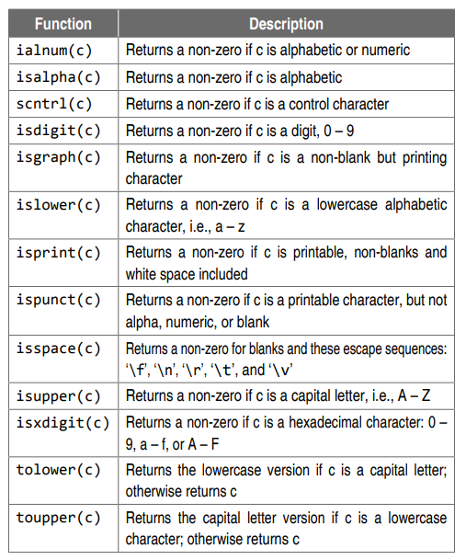
Character functions in where c is the character argument

Slide 47
